Slide 1

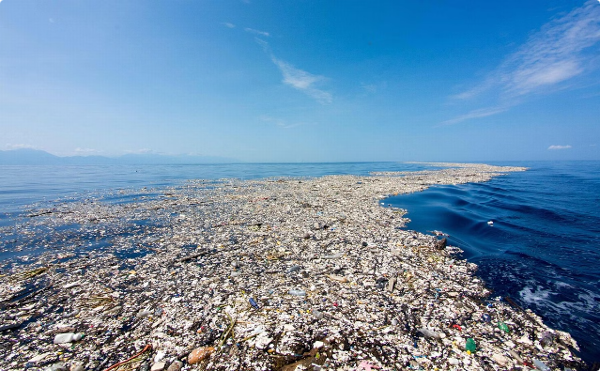
Introduction to Plastic Control
Plastic pollution is one of the most pressing environmental issues of our time. This presentation will explore the global challenge of plastic waste, effective strategies for plastic reduction, and innovative solutions for a more sustainable future.
by P. Pradhyumna Reddy

Slide 2

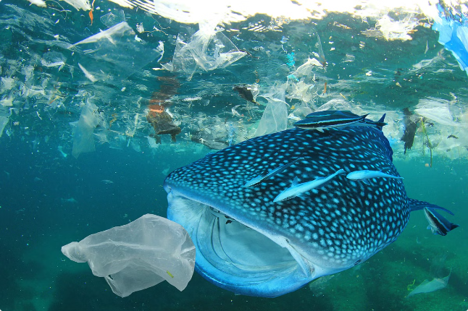
Plastic Pollution: The Global Challenge
1
Ubiquity of Plastic
Plastic has become an integral part of our daily lives, found in packaging, consumer goods, and even clothing.
2
Waste Accumulation
Billions of tons of plastic waste end up in landfills, oceans, and the environment each year, causing devastating harm to ecosystems and wildlife.
3
Environmental Impact
Plastic pollution contaminates soil, water, and air, threatening biodiversity, food chains, and human health.

Slide 3
Understanding Plastic Waste Streams
Single use plastics
Packaging Waste
Microplastics
Disposable items like plastic bags, straws, and utensils make up a significant portion of plastic waste.
Plastic packaging, such as bottles, containers, and wraps, account for a large volume of plastic waste.
Tiny plastic fragments from the breakdown of larger items are increasingly found in the environment and food chain.

Slide 4
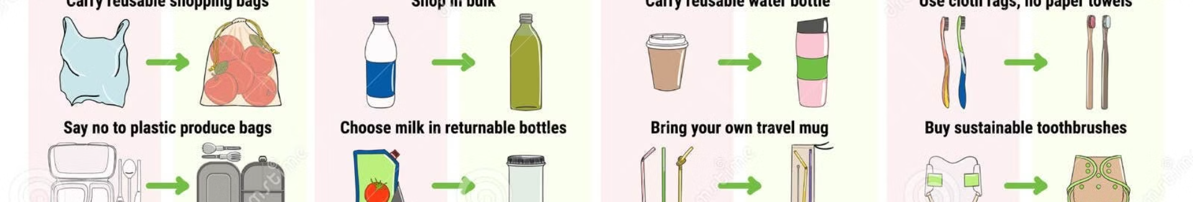
Strategies for Plastic Reduction
Reduce
1
Minimizing the use of single-use plastics and adopting reusable alternatives.
2
Reuse
Repurposing and extending the lifespan of plastic products through innovative design and consumer behavior.
Recycle
3
Improving recycling infrastructure and encouraging consumers to properly dispose of plastic waste.

Slide 5
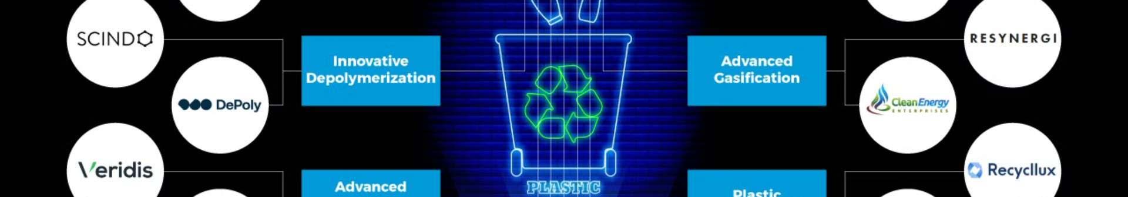
Innovative Recycling and Reuse Solutions
Advanced Recycling
Upcycling
Chemical recycling technologies that can break down complex plastic polymers and convert them into new raw materials.
Creative repurposing of plastic waste into high-value products, from fashion to furniture.
Circular Design
Waste-to-Energy
Designing plastic products for easy disassembly, repair, and recycling to eliminate waste.
Converting non-recyclable plastic waste into energy through thermal or biological processes.

Slide 6
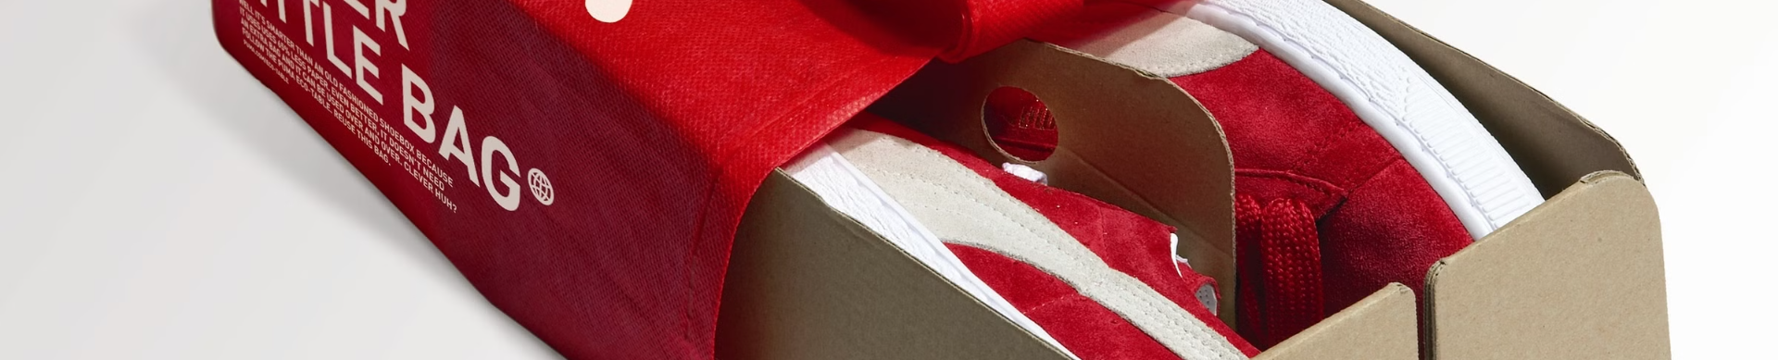


Sustainable Packaging Alternatives
Biodegradable
Recyclable
Refillable
Reduced
Plant-based, compostable packaging materials that break down naturally.
Packaging designed for easy recycling, reducing waste and resource consumption.
Reusable packaging systems that reduce single-use plastic waste.
Minimalist packaging that uses less material, lowering environmental impact.

Slide 7


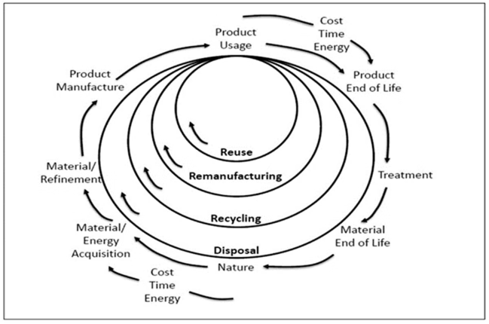


Engaging Stakeholders and Driving Change
Policy and Regulation
Governments implementing bans, taxes, and extended producer responsibility to incentivize plastic reduction.
Corporate Commitments
Businesses setting ambitious sustainability goals and investing in circular economy initiatives.
Consumer Awareness
Educating and empowering individuals to make sustainable choices and support change.

Slide 8
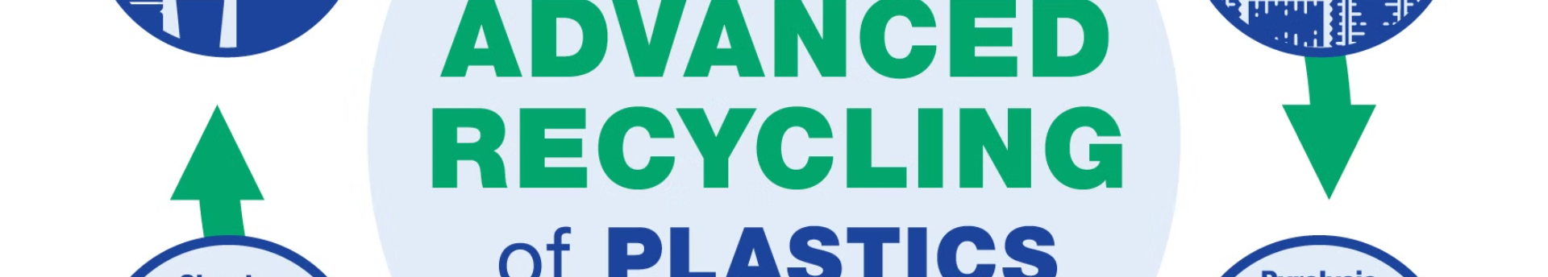
The Future of Plastic Control: Towards a Circular Economy
Eliminate
Phasing out unnecessary and problematic plastic products.
Innovate
Developing new materials, technologies, and business models to create a circular economy.
Circulate
Keeping plastics in use and out of the environment through reuse, repair, and recycling.

